Slide 1
CS 250 Lecture 38 - We interrupt our program to bring you …
2017.11.17
Never interrupt someone doing what you said could not be done.
Amelia Earhart

Slide 2
Announcements
HW11 posted, due Nov. 30
Monday, Nov. 20, no lecture
No office hours Monday, Nov. 20, 4:30-5:30pm
Mon. Nov. 20, MATH 175, 1:30pm & 3:30pm Optional lecture about breaking the Enigma code in World War II by Alan Turing and team at Bletchley Park
You and your guest(s) are invited

Slide 3
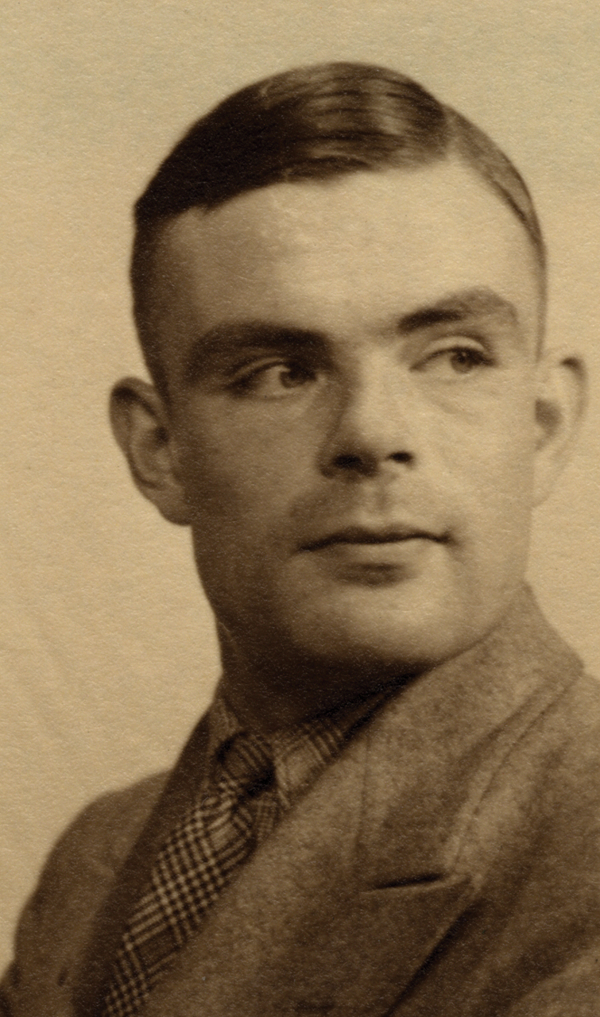

Alan Turing

Slide 5
Also called polled I/O
Cheap, cheap controller
circuit for device and bus
– How do we make a processor “wait”?
– We code a while loop for it to execute.
– Drawback: processor kept 100% busy just waiting; CPU cannot do anything else!
(Quelle nightmare.)

Slide 8
Array
Elements
0
1
2
3
4

Slide 9
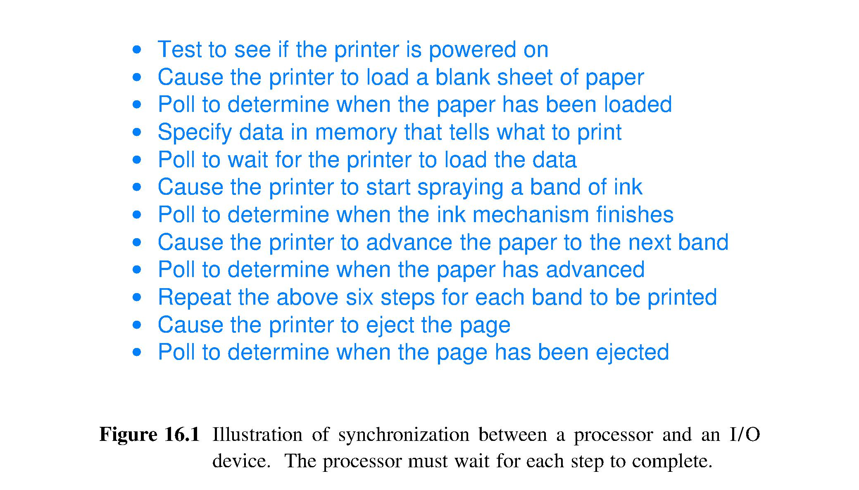
Example of polling to control printer

Slide 10
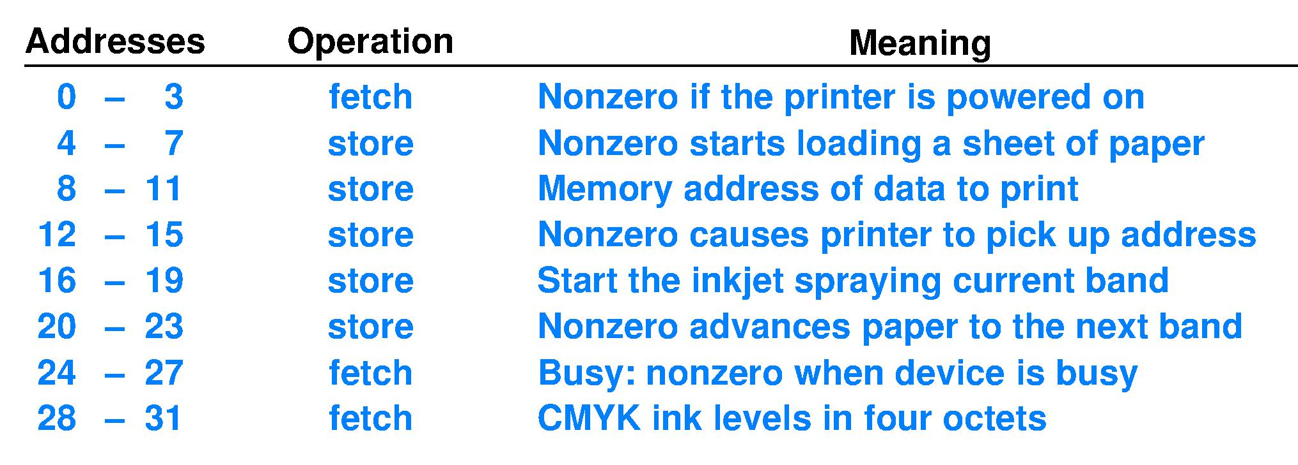
Example bus interface for ink-jet printer
List of the Control and Status “registers” for the ink-jet printer
For code on next slide, assume that Address 0 above (printer-relative) has been assigned physical address 0x110000.

Slide 11
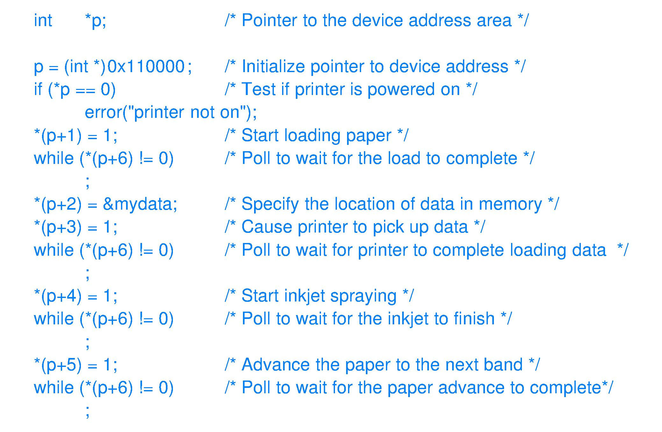
C code to poll
// Non-zero if printer is on
// Device is busy if *(p+6) != 0; proxy for “Load is complete”
// Busy now a proxy for “Data is loaded”
// This is not an infinite loop if the printer operates correctly
// Printer failure requires a system reboot

Slide 12
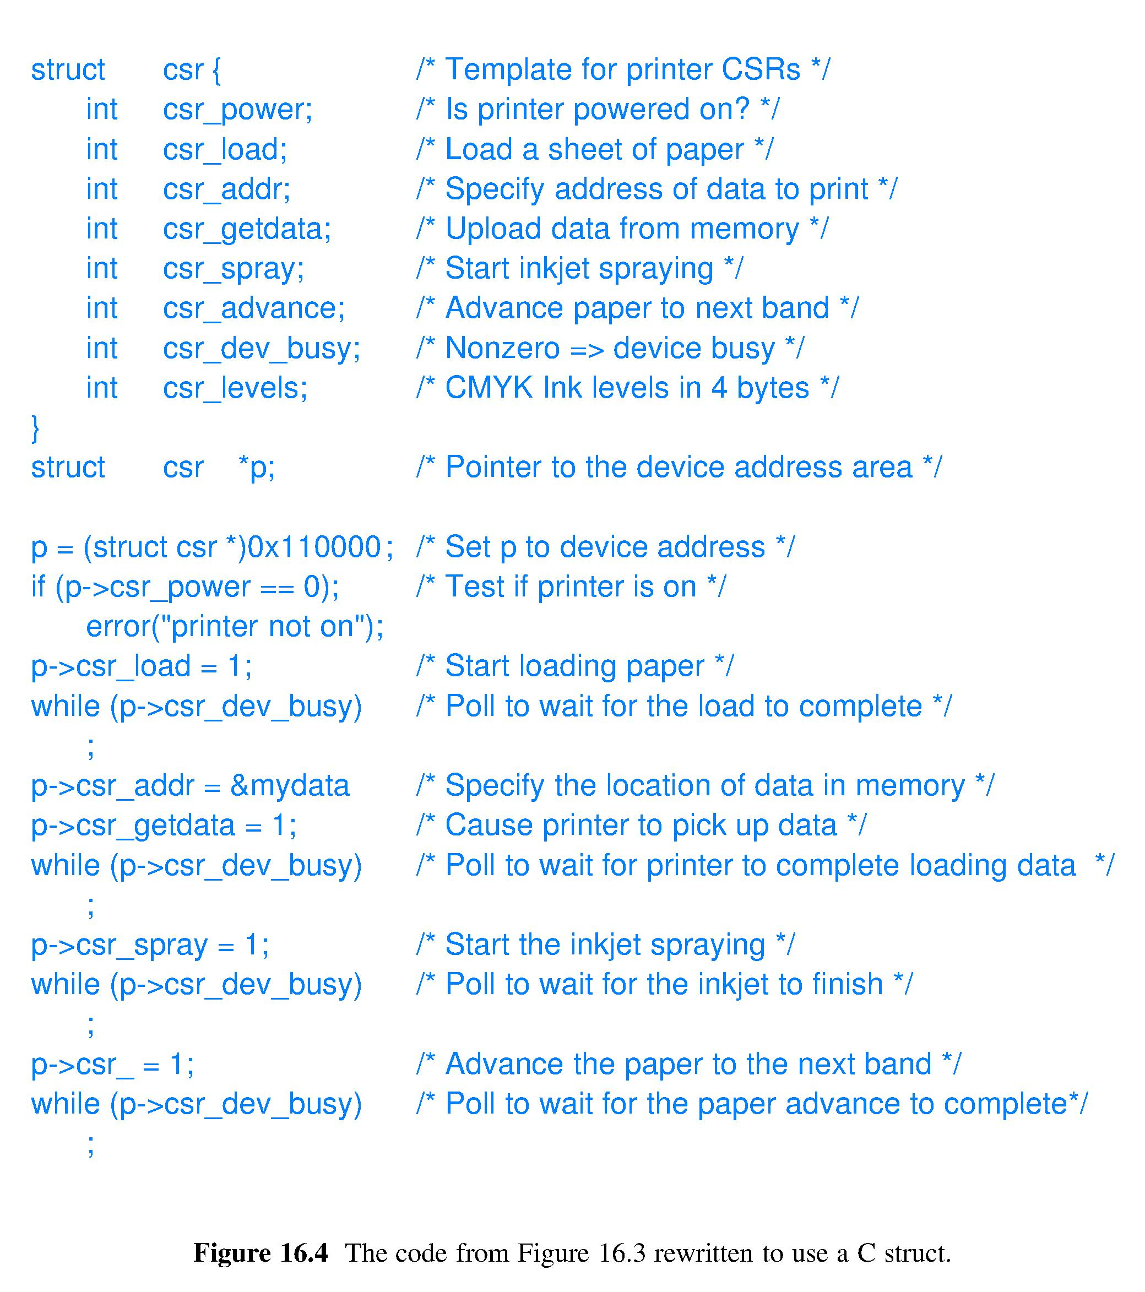
Polling code using struct

Slide 13
Programmed I/O: What’s to Like?
Pro
Cheap, bare-bones hardware can do it
Cheap, do not need an O/S
Con
Programmer must include I/O busy wait loop in App code
While waiting on one I/O need, cannot monitor any other I/O

Slide 14
– Makes good sense now that hardware is cheaper so that building smarter devices is feasible and since a CPU is wasted with polling (busy wait)

Slide 16
Synchronous with the CPU
within the app itself
^
“Asynch” with the CPU
System programmer, not every app programmer

Slide 17
Hardware inserts a “branch-and-link” into the instruction fetch stream

Slide 18
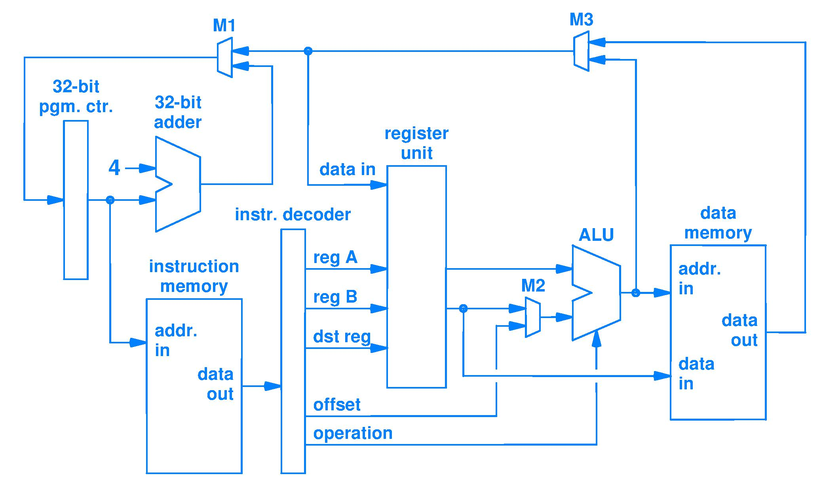
Modify Fetch-Execute to include Interrupts
Notes:
An in-class exercise for the students.
Pause and reflect.
Talk about Fig 3.8 as representing the three lines of code in the Fetch-Execute cycle: Fetch is the IF stage, execute is all the other stages, and Repeat forever is the feedback loop to the PC.
Now add ability to Interrupt between two instructions. (Mux in a choice of interrupt vector (address) to the input to the PC register.) Yes, more must be done to take care of all the housekeeping that an interrupt requires, but this additional source of input to the PC is the essence of a CPU that can be interrupted.

Slide 22
This is why when you boot up your computer it does not
respond to the keyboard or mouse for a while

